Slide 1

Web scraping to gain company insights
06/05/2024

Slide 2
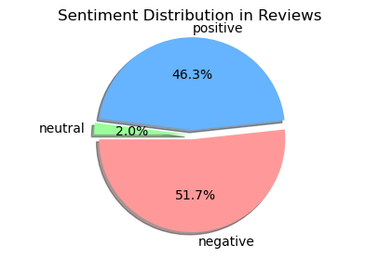
INSIGHTS FROM CUSTOMER REVIEWS
From cleaning 1000 reviews given by the customers, we obtained
Positive Reviews - 571
Negative Reviews - 463
Neutral Reviews – 20

Slide 3
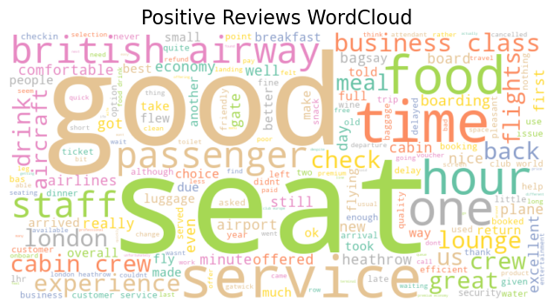
Wordcloud of Sentiments
Insights Gained:
In positive reviews, we can see words like great, comfortable, excellent, friendly.

Slide 4
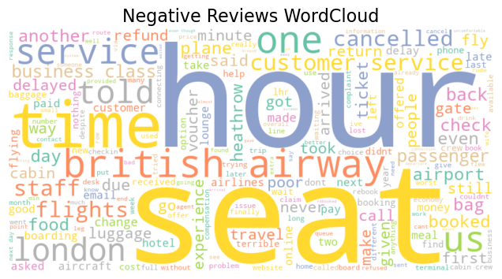
Wordcloud of Sentiments
Insights Gained:
In negative reviews, we may observe words like delay, worst, rude, unhelpful.

